Slide 1

Phishing: Analysis and Prevention
By: Nate A, Alex L, Esmeralda X, Asma A

Slide 2

Problem: What is Phishing?
Phishing is a type of cyber attack that uses email to send a link to an illegitimate website to steal personal information or to send an attachment that contains malware. It allows the attacker to:
steal login credentials
steal credit card information
access user's computer
Problems:
difficult to trace the source
causes financial damage
for businesses, they lose the trust of their customers

Slide 3

Solution
Implement database to track trusted sites
Develop chrome extension to flag unrecognized sites
Gather and analyze data

Slide 4
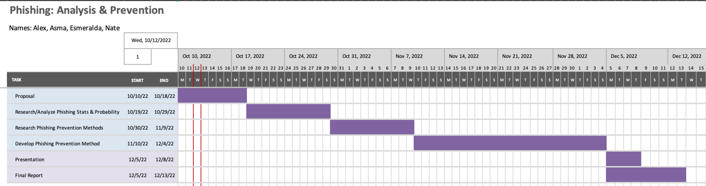
Plan/Timeline
What we’ve done
Created an example phishing email that directed users to a campusnet replica that we made. Upon attempt to login, users were “phished”. User data was sent to google analytics
Created a chrome extension using firebase database that held a record of trusted sites.
Untrusted sites raised an alert to the user
User can remove previously trusted site from database

Slide 5
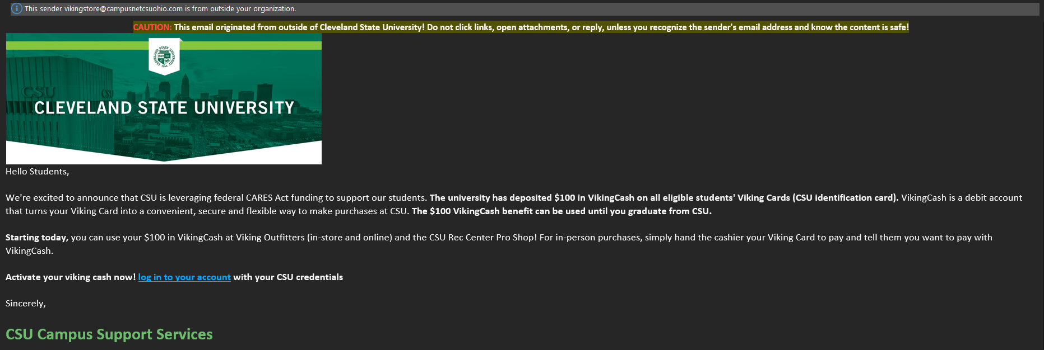
Phishing Email

Slide 6
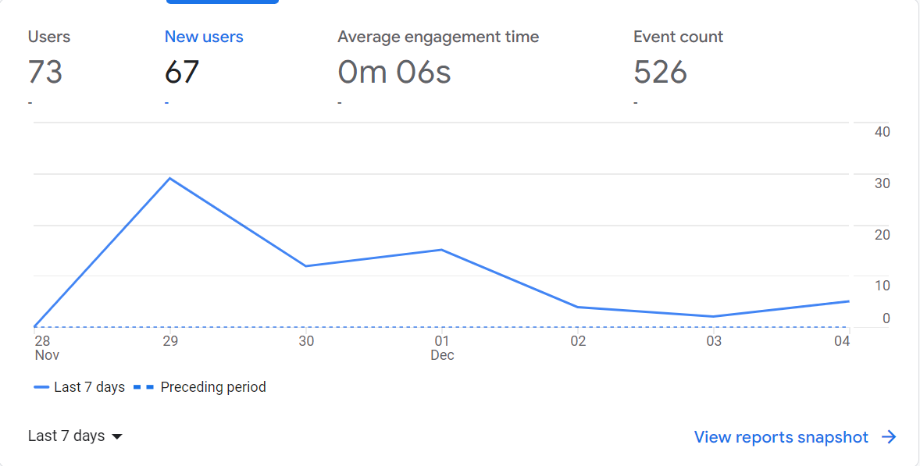
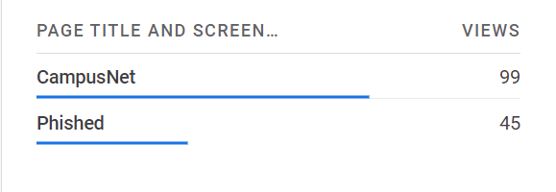
Data and analytics
About 45% of the views directed to our website, attempted to login and was “Phished”
Average engagement time for a user’s session was about 6 seconds, showing users may have clicked on and immediately clicked off
73 users is greater than the amount of students in the class showing out of class students may have had the email forwarded to them

Slide 7
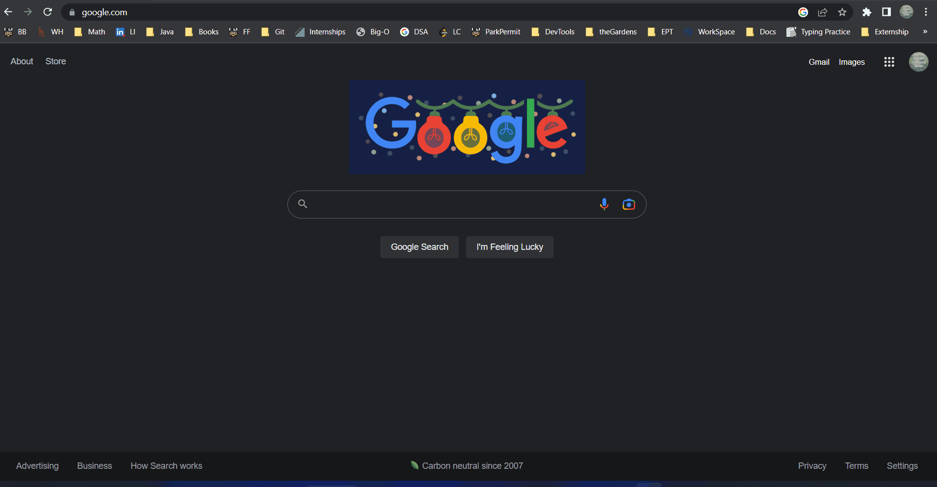
Demo

Slide 8
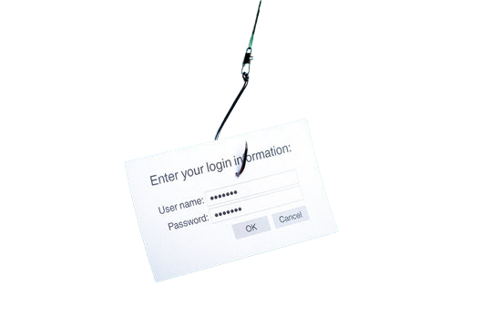
Conclusion
For this project:
We created our very own phishing email, sent to all of CIS 454 on 11/27
The email directed our classmates to click on our link redirecting them to a campus net look alike, when prompted to sign in, the users would see a page notifying them “you’ve been phished”.
Using Google Analytics, we gathered the data from the page to show the ease of manipulation when phishing
For a possible solution, we created a chrome extension that flags users of an unknown website.

Slide 9


